Slide 1
Pairwise local structural alignment of RNA sequences with sequence similarity less than 40%
Jakob Hull Havgaard, Rune B. Lyngso, Gary D. Stormo and Jan Gorodkin
Bioinformatics, Vol. 21 no. 9 2005, pages 1815–1824
Presenter : Hsiao-Yen Chang
Data : November 16, 2006

Slide 2
Abstract
Motivation: Searching for non-coding RNA (ncRNA) genes and
structural RNA elements (eleRNA) are major challenges in gene
finding today as these often are conserved in structure rather than
in sequence. Even though the number of available methods is
growing, it is still of interest to pairwise detect two genes with
low sequence similarity, where the genes are part of a larger
genomic region.
Results: Here we present such an approach for pairwise local
alignment which is based on FOLDALIGN and the Sankoff
algorithm for simultaneous structural alignment of multiple
sequences. We include the ability to conduct mutual scans of two
sequences of arbitrary length while searching for common local
structural motifs of some maximum length.

Slide 3
This drastically reduces the complexity of the algorithm. The scoring
scheme includes structural parameters corresponding to those
vailable for free energy as well as for substitution matrices similar to
IBOSUM. The new FOLDALIGN implementation is tested on a
dataset where the ncRNAs and eleRNAs have sequence similarity
<40% and where the ncRNAs and eleRNAs are energetically
indistinguishable from the surrounding genomic sequence context.
The method is tested in two ways: (1) its ability to find the common
structure between the genes only and (2) its ability to locate ncRNAs
and eleRNAs in a genomic context. In case (1), it makes sense to
compare with methods like Dynalign, and the performances are very
similar, but FOLDALIGN is substantially faster. The structure
prediction performance for a family is typically around 0.7 using
Matthews correlation coefficient. In case (2), the algorithm is
successful at locating RNA families with an average sensitivity of 0.8
and a positive predictive value of 0.9 using a BLAST-like hit
selection scheme.

Slide 4
Introduction
The FOLDALIGN is a simplified version of the Sankoff algorithm (Sankoff, 1985) which uses dynamic programming to locally align two sequences of lengths L1 and L2.
In contrast to the former version of FOLDALING, which is limited to maximizing a score, the version presented here employs substitution matrix schemes similar to Klein and Eddy (2003) including parameters corresponding to energy terms with similarities to those in Dynalign (Mathews and Turner, 2002).

Slide 5
Score matrices and parameters
Each score matrix has five parameters:gap opening, gap elongation, similarity clustering percentage, single-strand substitution matrix scale and base-pair substitution scale (Hofacker et al.,2004a).
Two types of parameters are used:
  The energy parameters are taken from mfold (Zuker et al., 1999; Mathews et al., 1999). All energy parameters have been multiplied by −10 mol/kcal and rounded to the nearest integer.
  The similarity parameters are log-odds substitution rates similar to RIBOSUM-matrices (Klein and Eddy, 2003) with two exceptions.

Slide 6
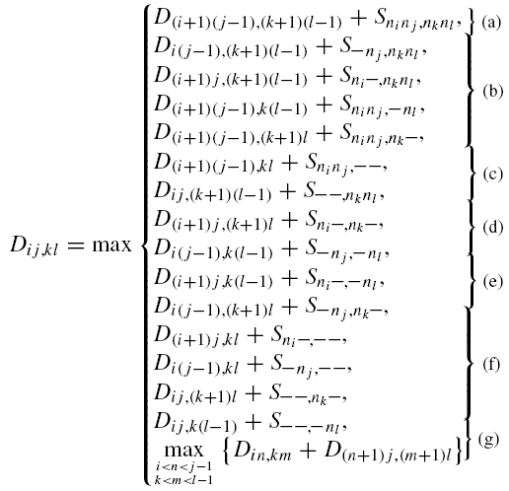
Computing scores and costs
The full recursion for computing the score D_{ij} ,_{kl} of aligning subsequence (i, j) to subsequence (k, l) can be written as
where n_{i} is the nucleotide at position i. Sninj ,nknl is the cost of substituting (n_{i} , n_{j} ) with (n_{k} , n_{l}) and while simultaneously folding the two subsequences.

Slide 7
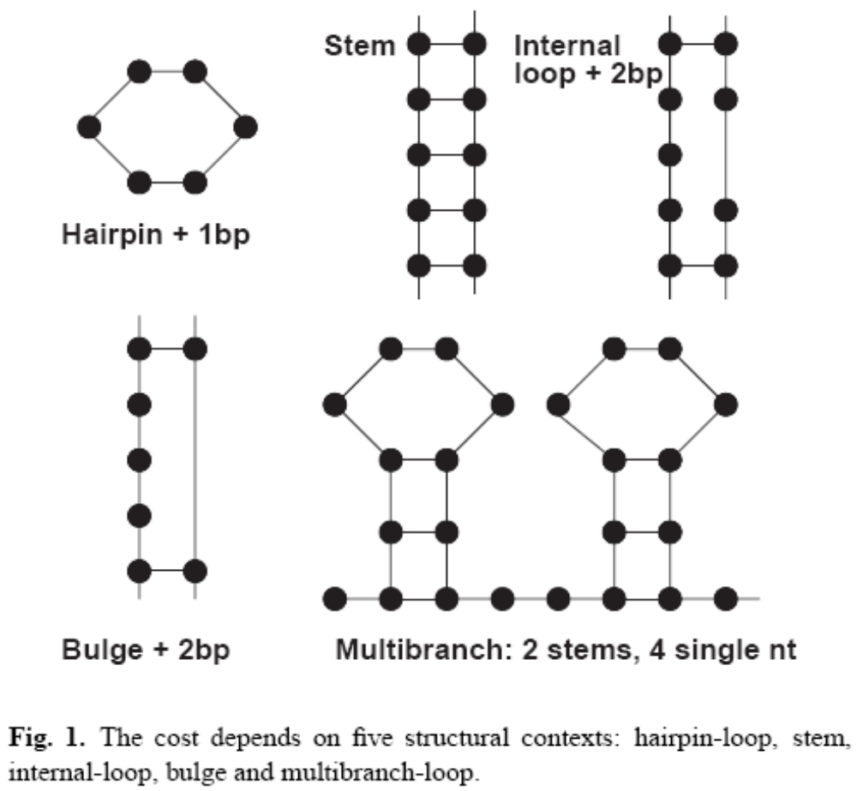
The dynamical computation of Sni nj ,nk nl depends on the five structural contexts: hairpin-loop, stem, internal-loop, bulge, and multibranch-loops.

Slide 8
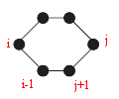
Hairpin-loop
The cost for aligning two hairpin-loops is:
S_{hp} = S_{substitution} + S_{length} + S_{stack}
where the cost Ssubstitution = ΣSss(n_{i} , n_{k}) is calculated by adding up the substitution and gap cost for each pair of nucleotides or gap in the loop. The single-strand substitution costs S_{ss}(n_{i} , n_{k}) are stored in the single-strand substitution matrix in the score matrix.
The cost Slength = Shp_length(j − i + 1) + Shp_length(l − k + 1) is a loop size dependent cost, calculated from energy parameters stored in the hairpin column of the loop length costs table in the score matrix.
The cost Sstack = Shp_stack(n_{i} , n_{j} , n_{i−1}, n_{j+1}) +Shp_stack(n_{k} , n_{l} , n_{k−1}, n_{l+1}) is calculated from the energy parameters stored in the hairpin close matrix in the score matrix.

Slide 9
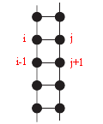
Stem
The score for aligning two stems has two parts:
Sbp = Ssubstitution + Sstack
The cost Ssubstitution = Sbp(n_{i} , n_{j} , n_{k} , n_{l}) is the sum of the costs for substituting the base-pairs in one subsequence with the base-pairs in the other. These base-pair substitution costs, S_{bp}, are stored in the base-pair substitution matrix in the score matrix.
The cost S_{stack} = S_{stacking}(n_{i} , n_{j} , n_{i−1}, n_{j+1}) +S_{stacking}(n_{k} , n_{l} , n_{k−1}, n_{l+1}) is the sum of the two independent sums of stackings in the two stems. The S_{stacking} cost is found in the stacking matrix in the score matrix.
  The stacking cost of the base-pair (i, j) depends on the base-pair (i − 1, j + 1).

Slide 10

Internal-loop
The score of an internal-loop has four parts:
Sil = Ssubstitution + Slength + Sasymmetry + Sstack
The cost Ssubstitution = Sss(n_{i} , n_{k}) + Sss(n_{j} , n_{l}) is the sum of the substitution costs for each pair of nucleotides in the loop. The substitution costs are those from the single-strand substitution matrix.
For an internal-loop spanning positions i’ − i and positions j’ − j , the internal-loop lengths are Δl_{i} = i − i’ + 1 and Δl_{j} = j − j’ + 1. The cost Slength = Sinternal(Δl_{i} + Δl_{j} ) + Sinternal(Δl_{k} +Δl_{l}) is calculated using the energy parameters stored in the internal column of the loop length costs table.

Slide 11
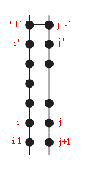
Internal-loop
The two sides of an internal-loop do not have to have same lengths, but the length difference has a cost which is proportional to the length difference.
  Sasymmetry = Sasym(| Δl_{i} −Δl_{j} |) + Sasym(|Δl_{k} −Δl_{l} |) is the sum of the two asymmetry costs.
The cost Sstack = Sil_stack(n_{i’},n_{j’} ,ni’+1,n_{j’−1}) + Sil_stack(n_{k’},n_{l’},n_{k’+1},n_{l’−1}) + Sil_stack(n_{i},n_{j}, n_{i-1},n_{j+1}) + Sil_stack(n_{k},n_{l},n_{k-1},n_{l+1}) is the sum of these four costs
for the two structures in the alignment.

Slide 12
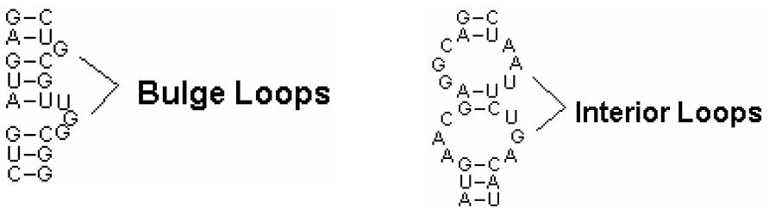
Bulge-loop
The cost of a bulge is:
Sbl = Ssubstitution + Slength + Sstack
The substitution cost is the same for the bulges and the internal-loops.
The cost Slength depends on the two bulge lengths and is stored in the bulge column of the loop length cost table.

Slide 13
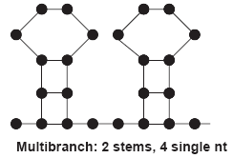
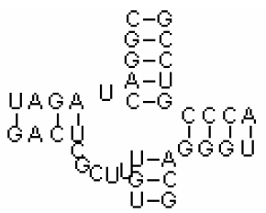
Multibranched-loop
Multibranched-loops are regions where ≥2 stems meet. The cost of a multibranch-loop is:
Smbl = Ssubstitution + Smbl_closing + (nstems − 2)Sstem
+ nsinglenucleotides × Snucleotide + Sstack
where Ssubstitution is calculated using the single-strand substitution matrix.
The cost Smbl_closing is added when a multibranch-loop is closed by a base-pair, Sstem is for each additional pair of conserved stems after the first two, and Snucleotide is added to each single-stranded nucleotide in the loop.
Single-stranded nucleotides next to a stem are stacked. The stackings are summed for both subsequences into the Sstack cost.

Slide 14


Mutual scan of two sequences and the algorithmic complexity
The algorithm as presented so far has a time complexity of and a memory complexity of .
The maximum length of the RNA-motif is limited to λ nucleotides, and the maximum length difference between two subsequences being compared is limited to δ nucleotides.
This lowers the time complexity to L1L2λ²δ². The memory complexity becomes L1L2λδ.

Slide 15
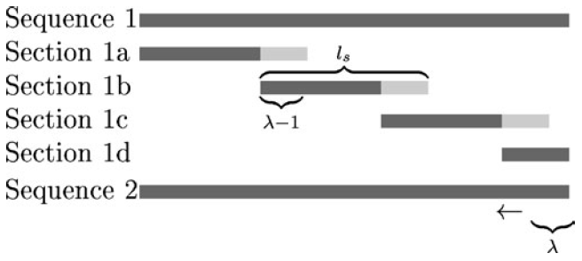
The full two sequences are still kept in memory giving the program a memory requirement of O(lsλ²δ + L1 + L2), where ls is length of the subsections.
The total run time scales as O(L1L2λ²δ² + Nλ⁴δ²), where N is the number of structures to be backtracked.
  If the sequence is split into (L1 −(λ − 1))/(ls − (λ − 1)) sections of length ls, the time complexity becomes O((L1/ls − λ)ls L2λ²δ²).
  The FOLDALIGN uses ls = 2λ as the default ls value.
  This adds another O(λ⁴δ²) per hit region.

Slide 16
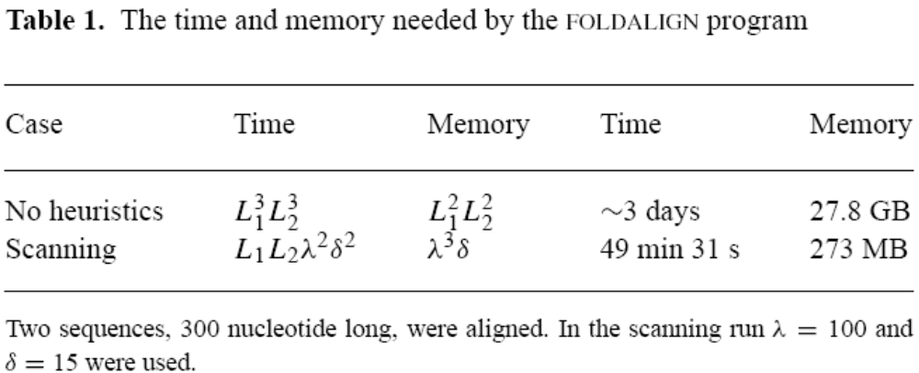
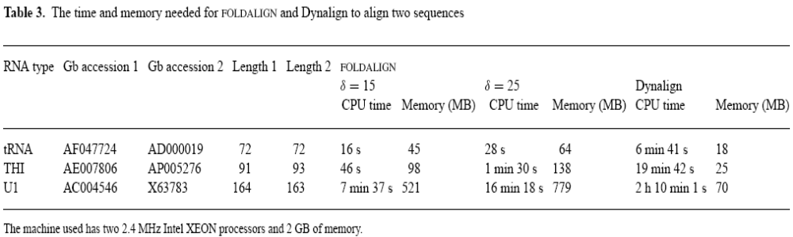

Slide 17
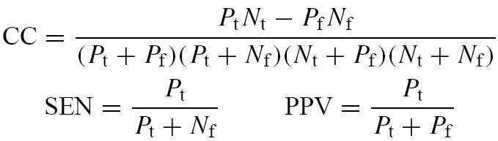
Performance evaluation
Three measures are used to evaluate the predictions: the Matthews correlation coefficient (CC) (Matthews, 1975), the sensitivity (SEN) and the positive predictive value (PPV) .
These are defined as:
For the structure predictions the correlation coefficient can be approximated as the geometric mean of the sensitivity and the positive predictive value, CC = √(SEN × PPV) (Gorodkin et al., 2001c).

Slide 18
Structure Predictions
The FOLDALIGN predicts a local alignment and structure for two sequences containing a common conserved RNA-motif.
To evaluate the algorithm’s ability to find the correct structure shared between two sequences the RNA-motif sequences were align without surrounding sequence.
  A predicted base-pair between positions i and j is considered as correctly predicted, true positive (Pt), if a base-pair is annotated between i and j , i ±1 and j, or I and j±1.
  Predicted base-pairs which pair other positions are counted as false positives (Pf).
  Annotated base-pairs which are not predicted are counted as false negatives (Nf).

Slide 19
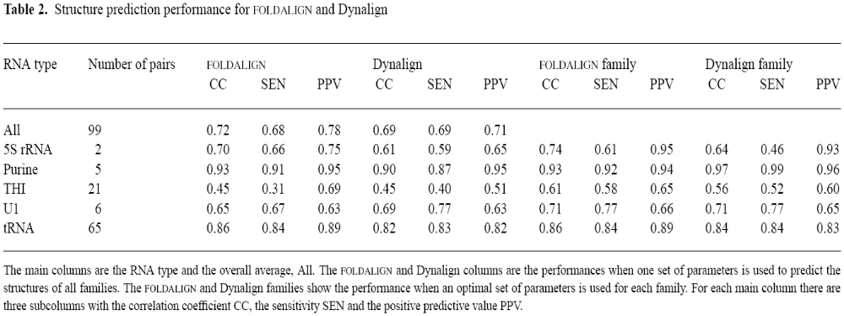
The motif dataset contains 99 RNA pairs and the long dataset also has 99 sequence pairs but a total of 295 gene pairs.
  All GenBank sequences were manually checked.

Slide 20
Localization
To test FOLDALIGN’s performance as a local alignment tool the dataset containing the RNA-motifs with their surrounding sequence was aligned.
  A predicted hit (alignment) is counted as a true positive (Pt), if for both sequences at least half the positions predicted as part of the alignment overlap an annotated motif.
  An alignment where less than of half the predicted positions are annotated on one or both sequences is counted as a false positive (Pf) alignment.
  Any alignments between two RNAs from the same family missing are counted as false negative (Nf) alignments.
    From the annotation of the sequences it is known which regions should be aligned.

Slide 21
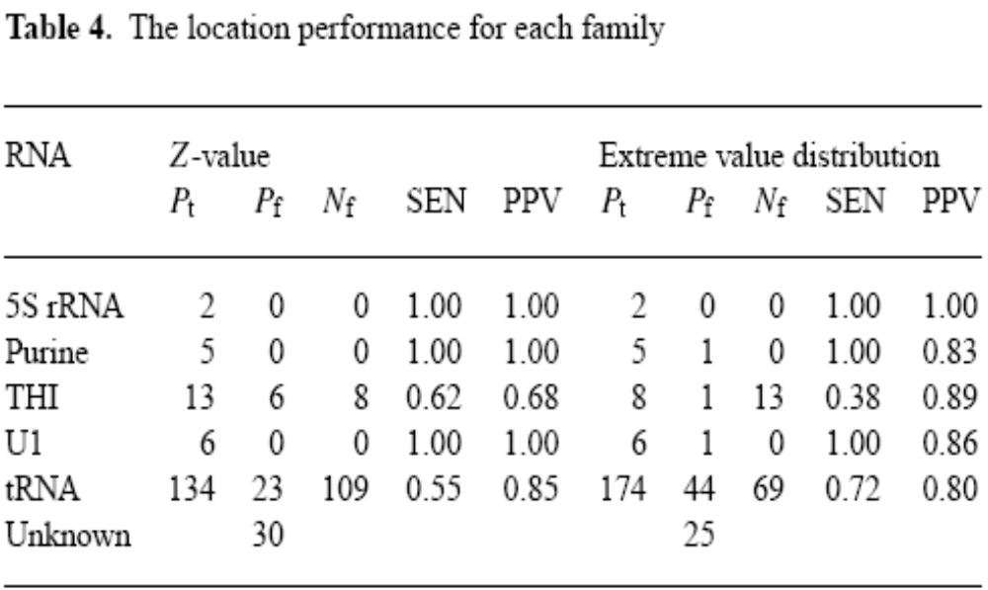
Selection of a hit region
  Z-value: The Z-score for all alignments in the list is calculated based on all the scores in the (i, k) matrix.
  Extreme value distribution: The scores from the alignment are assumed to follow an extreme value distribution in the same way as the scores from the BLAST program. (Karlin and Altschul, 1990).

